Slide 1

Elementary Particle Dynamics
Chapter 2

Slide 2
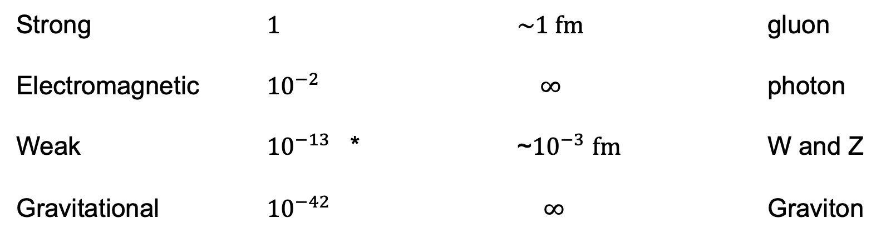
The Four Forces
Force Relative Strength Range Mediator
Strong 1 ~1 fm gluon
Electromagnetic ${10}^{−2}$ $∞$ photon
Weak ${10}^{−13}$ * ~${10}^{−3}$ fm W and Z
Gravitational ${10}^{−42}$ $∞$ Graviton

Slide 3
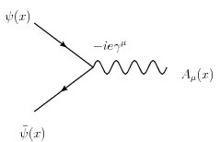
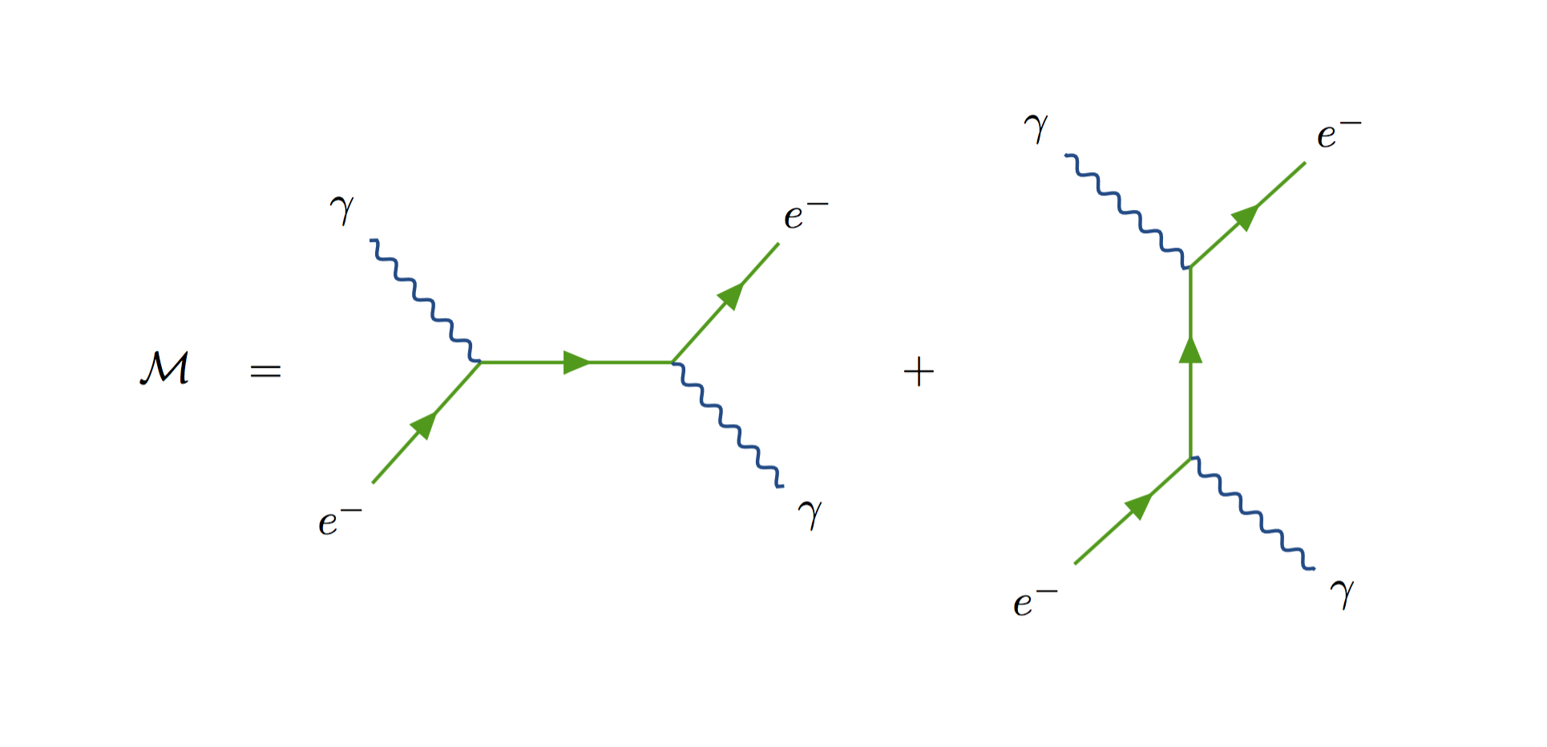
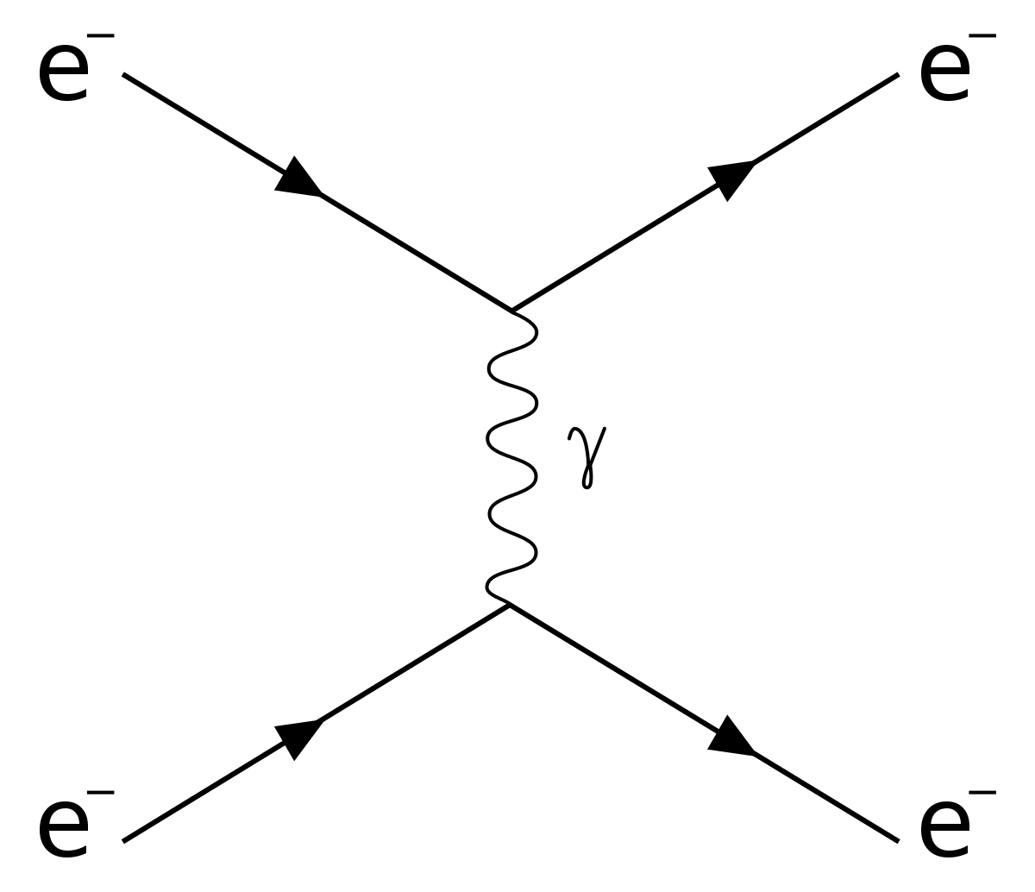
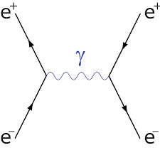
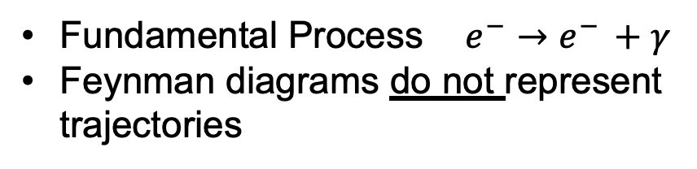
Quantum Electrodynamics (QED) Intro. To Feynman diagrams
Fundamental Process $e^{−}→e^{− }+γ$
Feynman diagrams do not represent
trajectories
Möller Scattering
Bhabha Scattering
Compton Scattering

Slide 4
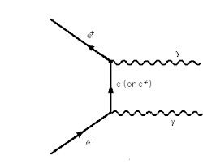
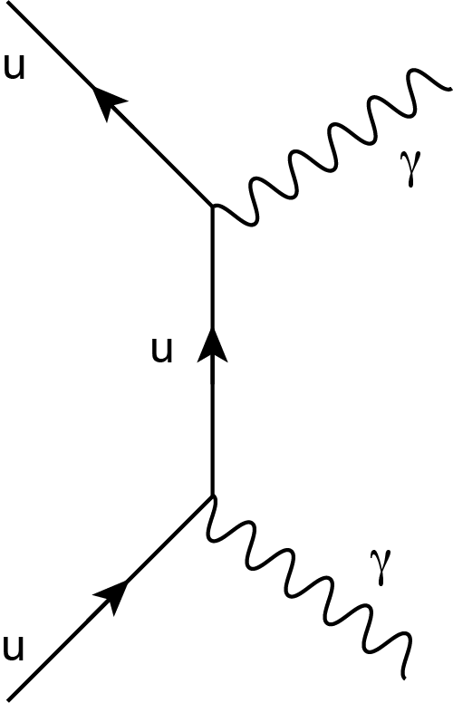
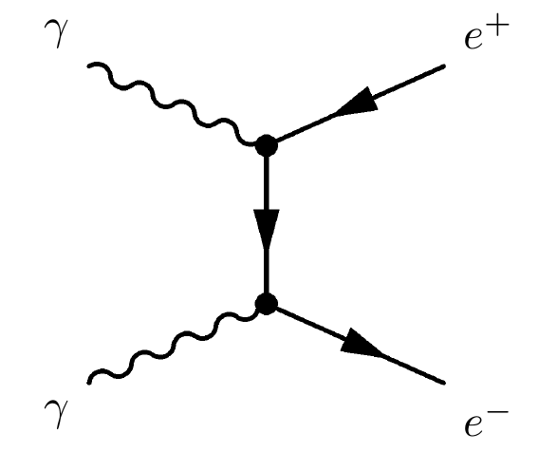
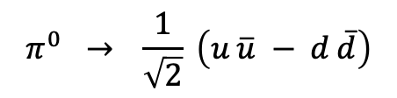



Quantum Electrodynamics (QED)
$$π^{0}→γ γ$$
$$e^{+} e^{−}→γ γ$$
$$γ γ→ e^{+} e^{−}$$
$$π^{0} → \frac{1}{\sqrt{2}} \left(u \overline{u} − d \overline{d}\right)$$

Slide 5
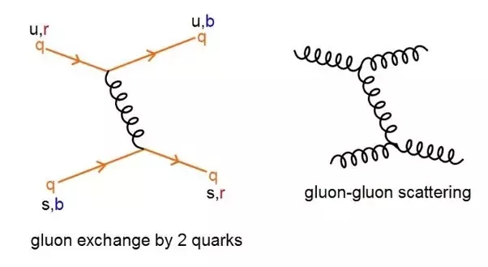
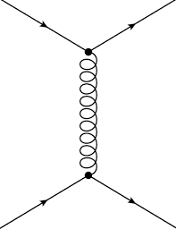
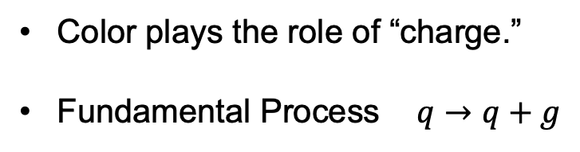
Quantum Chromodynamics (QCD)
Color plays the role of “charge.”
Fundamental Process $q→q+g$
q
q
q
q

Slide 6
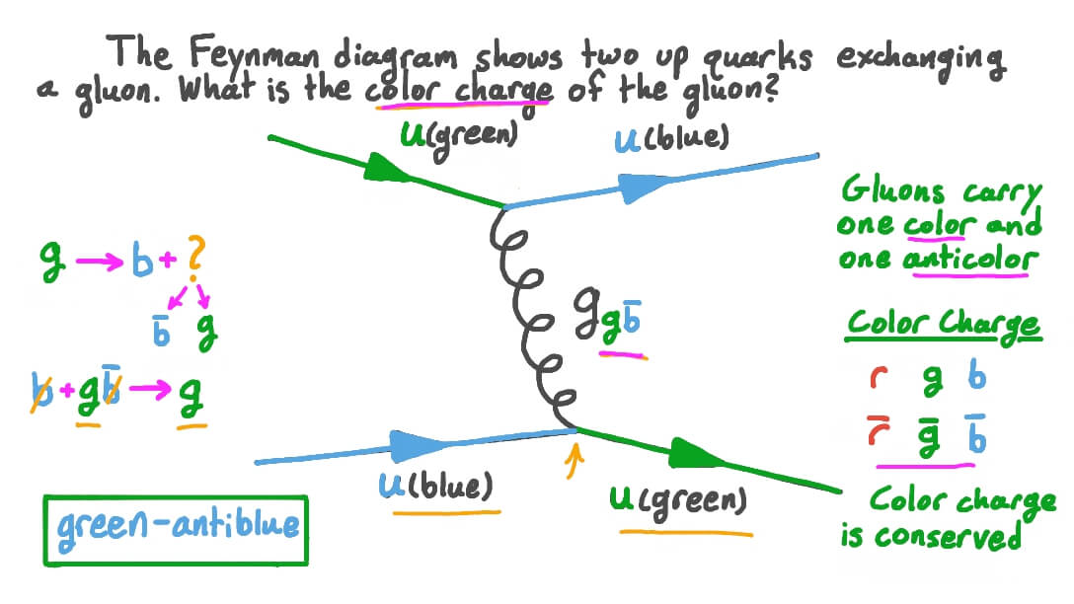
Quantum Chromodynamics (QCD)

Slide 7
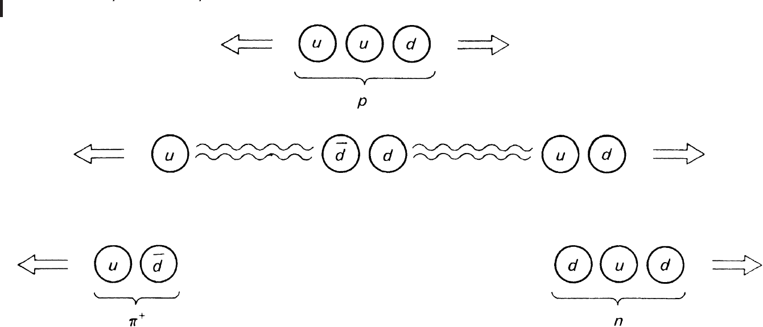
Strong Interactions
What happens when you try to separate two quarks?

Slide 8
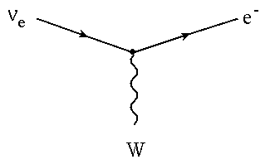
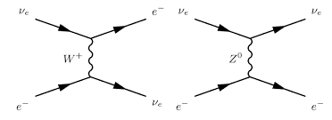
Weak Interactions
Fundamental Interaction
+
Charged and Neutral Currents

Slide 9
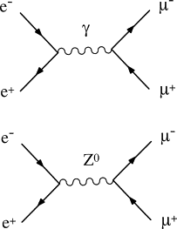
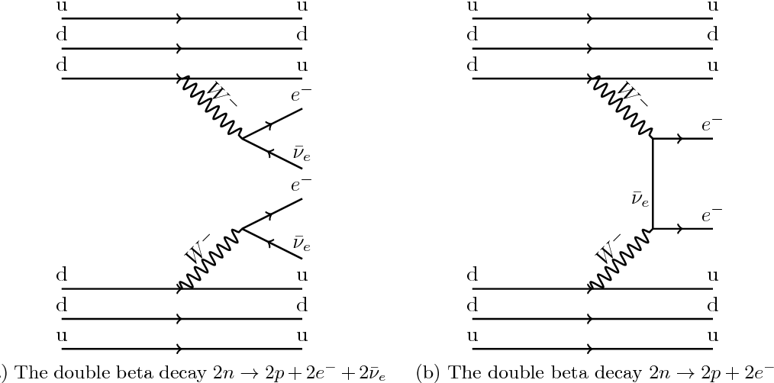
Weak Interactions
Electroweak Interactions
Double Beta Decay

Slide 10
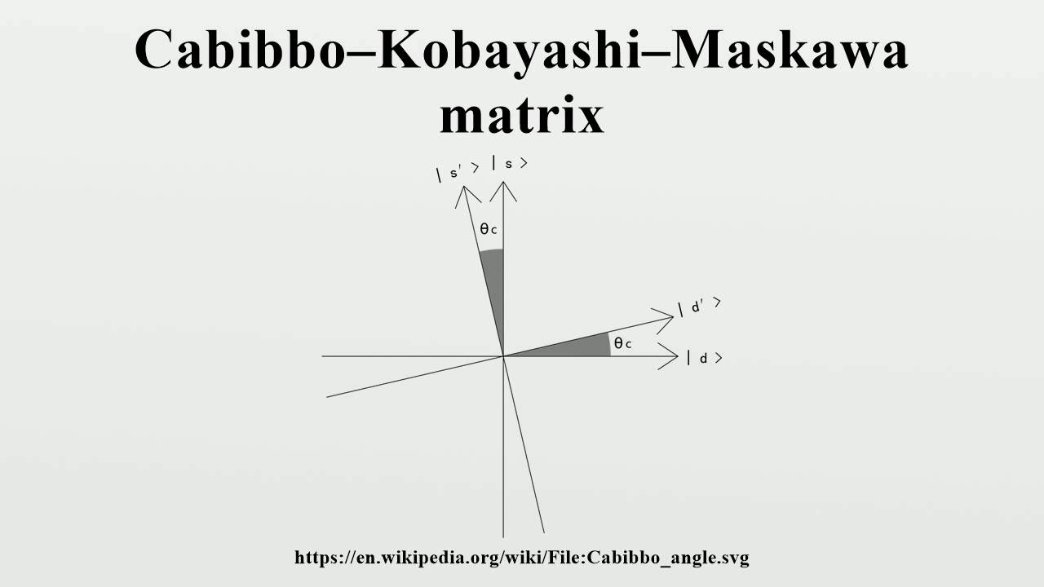
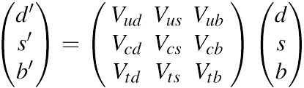
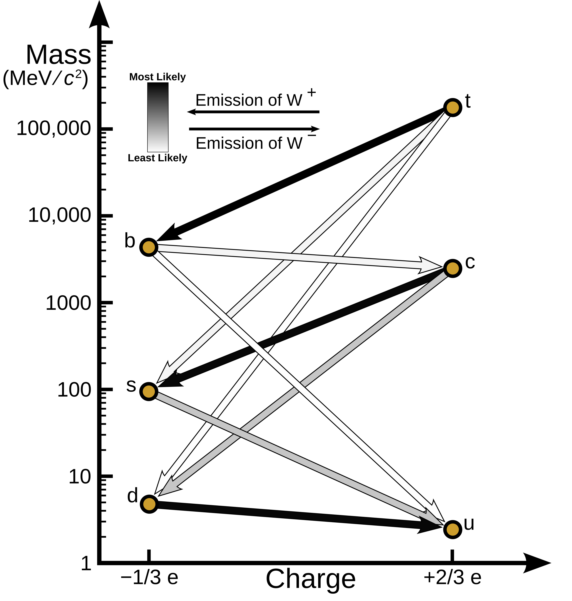
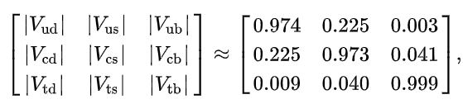
The Cabibbo-Kobayashi-Maskawa matrix C-K-M matrix
Weak (observed)
eigenstates
Mass eigenstates

Slide 11
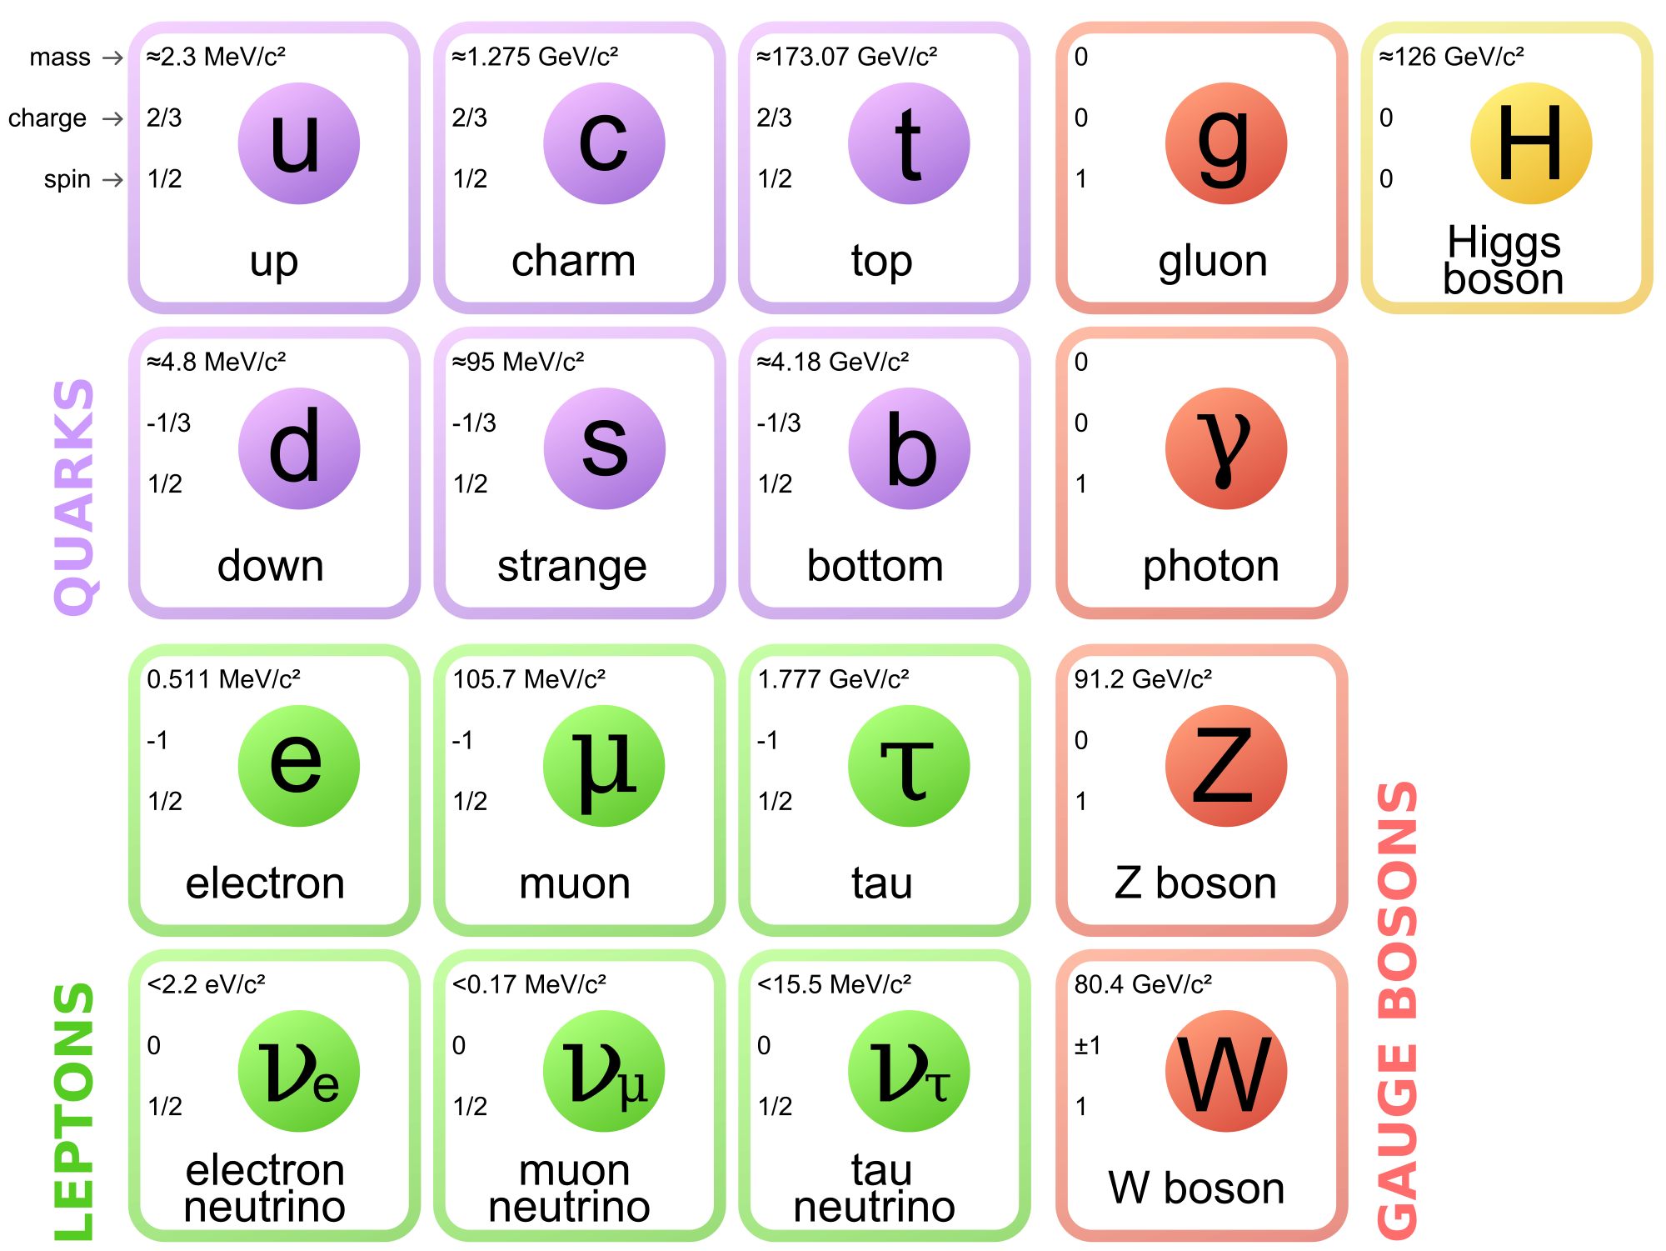
Kobayashi – Maskawa Matrix (cont’d)

Slide 12
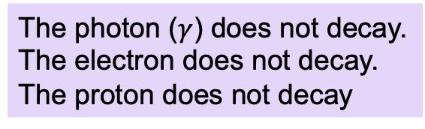
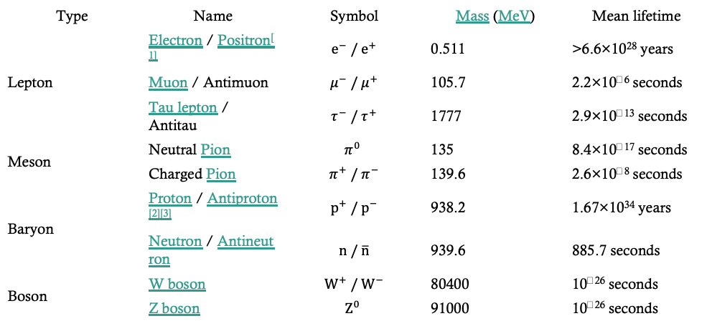
Decays and Conservation Laws
Every particle decays into lighter particles, unless prevented by some conservation law.
The photon ($γ$) does not decay.
The electron does not decay.
The proton does not decay
There is no particle lighter than a photon.
Conservation of charge
Conservation of baryon number
Type | Name | Symbol | Mass (MeV) | Mean lifetime
Lepton | Electron / Positron^{[1]} | $$e^{−} / e^{+}$$ | 0.511 | >6.6×10²⁸ years
 | Muon / Antimuon | $$μ^{−} / μ^{+}$$ | 105.7 | 2.2×10⁻⁶ seconds
 | Tau lepton / Antitau | $$τ^{−} / τ^{+}$$ | 1777 | 2.9×10⁻¹³ seconds
Meson | Neutral Pion | $$π^{0}$$ | 135 | 8.4×10⁻¹⁷ seconds
 | Charged Pion | $$π^{+} / π^{−}$$ | 139.6 | 2.6×10⁻⁸ seconds
Baryon | Proton / Antiproton^{[2][3]} | $$p^{+} / p^{−}$$ | 938.2 | 1.67×10³⁴ years
 | Neutron / Antineutron | $$n / \overline{n}$$ | 939.6 | 885.7 seconds
Boson | W boson | $$W^{+} / W^{−}$$ | 80400 | 10⁻²⁶ seconds
 | Z boson | $$Z^{0}$$ | 91000 | 10⁻²⁶ seconds

Slide 13
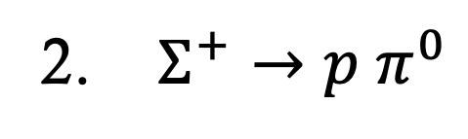
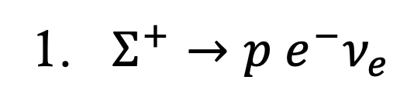
Example
Which of these two decays occurs more rapidly?
1. $Σ^{+}→p e^{−}ν_{e}$
2. $Σ^{+}→p π^{0}$

Slide 14
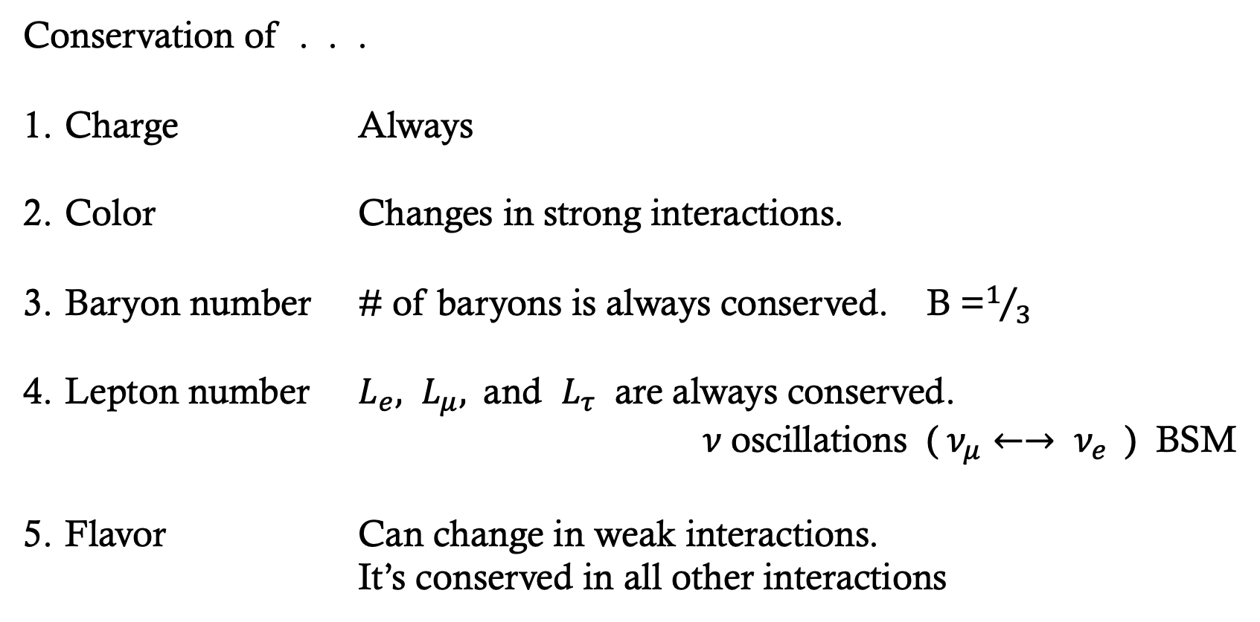
Decays and Conservation Laws
Conservation of . . .
Charge Always
Color Changes in strong interactions.
Baryon number # of baryons is always conserved. B =$1/3$
Lepton number $L_{e}, L_{μ},$and $L_{τ}$ are always conserved.
$ν$oscillations ($ν_{μ}←→ ν_{e}$) BSM
Flavor Can change in weak interactions.
It’s conserved in all other interactions

